Slide 1
Chapter 3
Organization: Structure and Culture

Slide 2

Project Management Structures
Challenges to Organizing Projects
  The uniqueness and short duration of projects relative to ongoing longer-term organizational activities
  The multidisciplinary and cross-functional nature of projects creates authority and responsibility dilemmas.
Choosing an Appropriate Project Management Structure
  The best system balances
  the needs of the project
  with the needs of the
  organization.
Copyright © 2006 The McGraw-Hill Companies. All rights reserved.
McGraw-Hill/Irwin 3–<number>

Slide 3
Project Management Structures
Organizing Projects: Functional organization
  Different segments of the project are delegated to respective functional units.
  Coordination is maintained through normal management channels.
  Used when the interest of one functional area dominates the project or one functional area has a dominant interest in the project’s success.
Copyright © 2006 The McGraw-Hill Companies. All rights reserved.
McGraw-Hill/Irwin 3–<number>

Slide 4
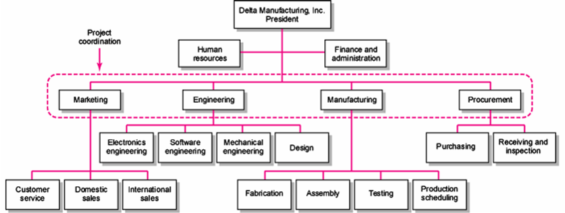
Functional Organizations
FIGURE 3.1
Copyright © 2006 The McGraw-Hill Companies. All rights reserved.
McGraw-Hill/Irwin 3–<number>

Slide 5
Functional Organization of Projects
Advantages
  No Structural Change
  Flexibility
  In-Depth Expertise
  Easy Post-Project Transition
Disadvantages
  Lack of Focus
  Poor Integration
  Slow
  Lack of Ownership
Copyright © 2006 The McGraw-Hill Companies. All rights reserved.
McGraw-Hill/Irwin 3–<number>

Slide 6
Project Management Structures (cont’d)
Organizing Projects: Dedicated Teams
  Teams operate as separate units under the leadership of a full-time project manager.
  In a projectized organization where projects are the dominant form of business, functional departments are responsible for providing support for its teams.
Copyright © 2006 The McGraw-Hill Companies. All rights reserved.
McGraw-Hill/Irwin 3–<number>

Slide 7
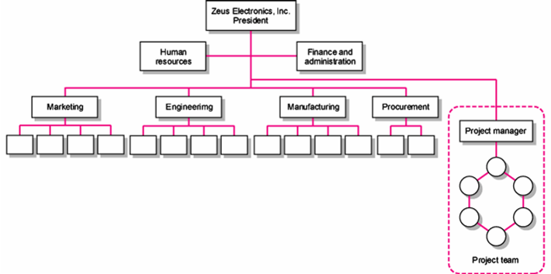
Dedicated Project Team
FIGURE 3.2
Copyright © 2006 The McGraw-Hill Companies. All rights reserved.
McGraw-Hill/Irwin 3–<number>

Slide 8
Project Organization: Dedicated Team
Advantages
  Simple
  Fast
  Cohesive
  Cross-Functional Integration
Disadvantages
  Expensive
  Internal Strife
  Limited Technological Expertise
  Difficult Post-Project Transition
Copyright © 2006 The McGraw-Hill Companies. All rights reserved.
McGraw-Hill/Irwin 3–<number>

Slide 9
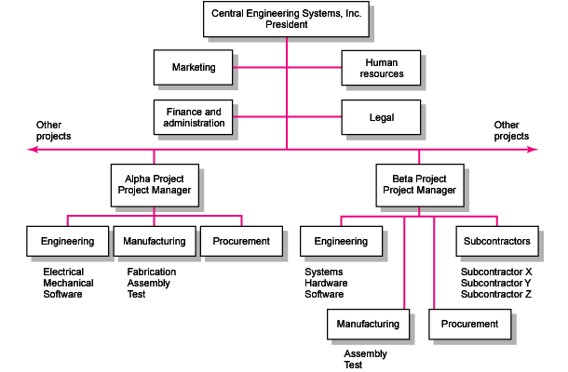
Project Organizational Structure
FIGURE 3.3
Copyright © 2006 The McGraw-Hill Companies. All rights reserved.
McGraw-Hill/Irwin 3–<number>

Slide 10
Project Management Structures (cont’d)
Organizing Projects: Matrix Structure
  Hybrid organizational structure (matrix) is overlaid on the normal functional structure.
    Two chains of command (functional and project)
    Project participants report simultaneously to both functional and project managers.
  Matrix structure optimizes the use of resources.
    Allows for participation on multiple projects while performing normal functional duties.
    Achieves a greater integration of expertise and project requirements.
Copyright © 2006 The McGraw-Hill Companies. All rights reserved.
McGraw-Hill/Irwin 3–<number>

Slide 11
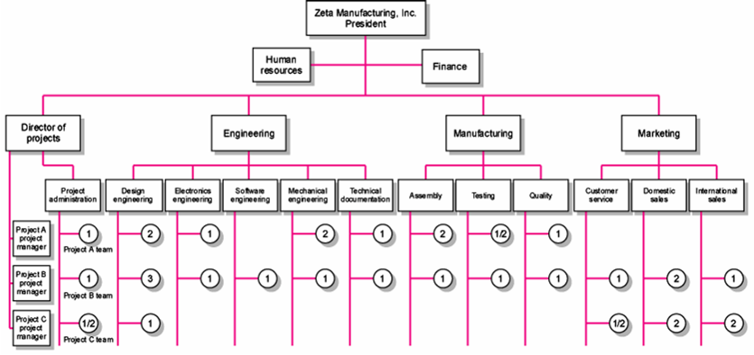
Matrix Organization Structure
FIGURE 3.4
Copyright © 2006 The McGraw-Hill Companies. All rights reserved.
McGraw-Hill/Irwin 3–<number>

Slide 12
Division of Project Manager and Functional Manager Responsibilities in a Matrix Structure
Project Manager Negotiated Issues Functional Manager
What has to be done? Who will do the task? How will it be done?
When should the task be done? Where will the task be done?
How much money is available to Why will the task be done? How will the project involvement
do the task? impact normal functional activities?
How well has the total project Is the task satisfactorily How well has the functional
been done? completed? input been integrated?
TABLE 3.1
Copyright © 2006 The McGraw-Hill Companies. All rights reserved.
McGraw-Hill/Irwin 3–<number>

Slide 13
Different Matrix Forms
Functional (also Weak or Lightweight) Form
  Matrices in which the authority of the functional manager predominates and the project manager has indirect authority.
Balance (or Middleweight) Form
  The traditional matrix form in which the project manager sets the overall plan and the functional manager determines how work to be done.
Strong (Heavyweight) Form
  Resembles a project team in which the project manager has broader control and functional departments act as subcontractors to the project.
Copyright © 2006 The McGraw-Hill Companies. All rights reserved.
McGraw-Hill/Irwin 3–<number>

Slide 14
Project Organization: Matrix Form
Advantages
  Efficient
  Strong Project Focus
  Easier Post-Project Transition
  Flexible
Disadvantages
  Dysfunctional Conflict
  Infighting
  Stressful
  Slow
Copyright © 2006 The McGraw-Hill Companies. All rights reserved.
McGraw-Hill/Irwin 3–<number>

Slide 15

Project Management Structures (cont’d)
Organizing Projects: Network Organizations
  An alliance of several organizations for the purpose of creating products or services.
    A “hub” or “core” firm with strong core competencies outsources key activities to a collaborative cluster of satellite organizations.
Copyright © 2006 The McGraw-Hill Companies. All rights reserved.
McGraw-Hill/Irwin 3–<number>

Slide 16
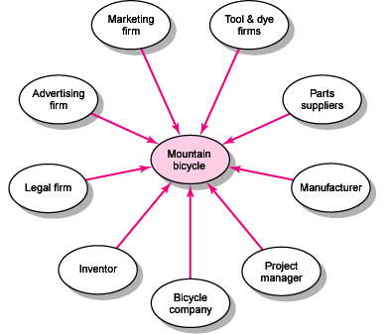
Mountain Bicycle Network Project
FIGURE 3.5
Copyright © 2006 The McGraw-Hill Companies. All rights reserved.
McGraw-Hill/Irwin 3–<number>

Slide 17
Project Organization: Network Form
Advantages
  Cost Reduction
  High Level of Expertise
  Flexible
Disadvantages
  Coordination of Breakdowns
  Loss of Control
  Conflict
Copyright © 2006 The McGraw-Hill Companies. All rights reserved.
McGraw-Hill/Irwin 3–<number>

Slide 18
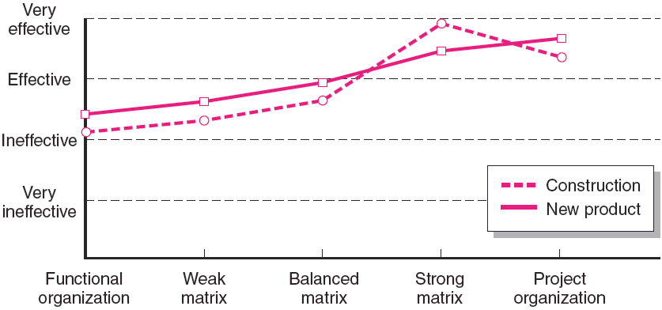
Rated Effectiveness of Different Project Structures by Type of Project
Source: Larson, E. W., and Gobeli, D. H., “Matrix Management: Contradictions and Insights,” California Management Review, vol. 29, no. 4 (Summer 1987), p. 137.
FIGURE 3.6
Copyright © 2006 The McGraw-Hill Companies. All rights reserved.
McGraw-Hill/Irwin 3–<number>

Slide 19

Choosing the Appropriate Project Management Structure
Organization (Form) Considerations
  How important is the project to the firm’s success?
  What percentage of core work involves projects?
  What level of resources (human and physical) are available?
Copyright © 2006 The McGraw-Hill Companies. All rights reserved.
McGraw-Hill/Irwin 3–<number>

Slide 20
Choosing the Appropriate Project Management Structure (cont’d)
Project Considerations
  Size of project
  Strategic importance
  Novelty and need for innovation
  Need for integration (number of departments involved)
  Environmental complexity (number of external interfaces)
  Budget and time constraints
  Stability of resource requirements
Copyright © 2006 The McGraw-Hill Companies. All rights reserved.
McGraw-Hill/Irwin 3–<number>

Slide 21
Organizational Culture
Organizational Culture Defined
  A system of shared norms, beliefs, values, and assumptions which bind people together, thereby creating shared meanings.
  The “personality” of the organization that sets it apart from other organizations.
    Provides a sense of identify to its members.
    Helps legitimize the management system of the organization.
    Clarifies and reinforces standards of behavior.
Copyright © 2006 The McGraw-Hill Companies. All rights reserved.
McGraw-Hill/Irwin 3–<number>

Slide 22
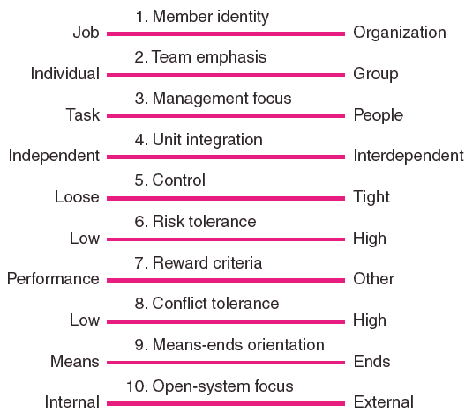
Key Dimensions Defining an Organization’s Culture
FIGURE 3.7
Copyright © 2006 The McGraw-Hill Companies. All rights reserved.
McGraw-Hill/Irwin 3–<number>

Slide 23
Identifying Cultural Characteristics
Study the physical characteristics of an organization.
Read about the organization.
Observe how people interact within the organization.
Interpret stories and folklore surrounding the organization.
Copyright © 2006 The McGraw-Hill Companies. All rights reserved.
McGraw-Hill/Irwin 3–<number>

Slide 24
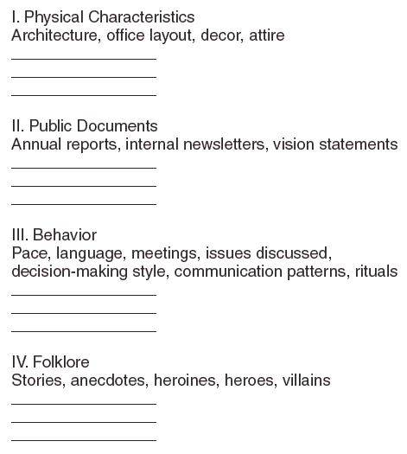
Organizational Culture Diagnosis Worksheet
FIGURE 3.8
Copyright © 2006 The McGraw-Hill Companies. All rights reserved.
McGraw-Hill/Irwin 3–<number>

Slide 25

Implications of Organizational Culture
for Organizing Projects
Challenges for Project Managers in Navigating Organizational Cultures
  Interacting with the culture and subcultures of the parent organization
  Interacting with the project’s clients or customer organizations
  Interacting with other organizations
  connected to the project
Copyright © 2006 The McGraw-Hill Companies. All rights reserved.
McGraw-Hill/Irwin 3–<number>

